Slide 1

AMIDS
Advanced Metering Infrastructure with Detection System

Slide 2
30th June 2014
A Multi-Sensor Energy Theft Detection
Framework for Advanced Metering Infrastructures
Reference
IEEE Journal Paper
Date of Current Version : 26 June 2013
Issue Date : July 2013
Publisher : IEEE
Published in : Selected Areas in Communications, IEEE Journal on (Volume:31 , Issue: 7 )
LEO .K .A S7 EEE Roll No : 38

Slide 3
Abstract
Crucial component of the smart grid.
For efficient management of many end-users
Remote exploits and local physical tampering with the end goal of stealing energy.
AMIDS - an AMI intrusion detection system that uses information fusion to combine the sensors and consumption data from a smart meter to more accurately detect energy theft.
AMIDS combines meter audit logs of physical and cyber events with consumption data to more accurately model and detect theft-related behavior.
AMIDS: Advanced Metering Infrastructure with Detection System
03

Slide 4
CONTENTS
Introduction
Related works
Threat Model
Individual Energy Theft Detection System Mechanisms Physical Tampering Detection Solutions Cyber Intrusion Detection Systems
Power Measurement-based Anomaly Detection
Multi-source Information Fusion
Experimental Evaluations
Results and Future Scope
Conclusions
AMIDS: Advanced Metering Infrastructure with Detection System
04

Slide 5
INTRODUCTION
The Advanced Metering Infrastructure (AMI)
Whats AMI and its Advantages ???
Changes the way
Eliminates man power
Reports every events taking place
Mitigate energy theft AMI Deployment in US :
Theft attempt that may have cost up
to 400 million dollars annually to a utility following an
AMI deployment , In 2009 as reported by FBI.
Arise of New Threats !!!
AMIDS: Advanced Metering Infrastructure with Detection System
05

Slide 6
Need for a new infrastucture – AMIDS
Cyber-physical intrusion detection system to identify malicious energy theft attempts. AMIDS uses an attack graph based information fusion technique detect theft-related behavior while reducing false positives.
Whats New ???!
Cyber-side Network- And Host-based Intrusion Detection Systems.
On-meter Anti-tampering Sensors.
Power Measurement-based Anomalous Consumption Detectors Through Nonintrusive Load Monitoring (NILM)
AMIDS: Advanced Metering Infrastructure with Detection System
06

Slide 7
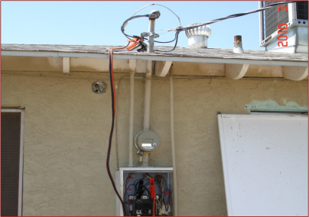


THREAT MODEL
AMIDS: Advanced Metering Infrastructure with Detection System
07

Slide 8
Cyber Attack technique | Physical Attack technique | Effect on Power Measurement
Compromise meters through remote network exploit . | Break into the meter | Stop reporting entire consumption
Modify the firmware/storage on meters. | Reverse the meter | Remove large applicances from measurement
Steal credentials to login to meters | Disconnect the meter | Cut the report by a given percentage
Exhaust CPU/memory | Physically extract the password | Alter appliance load profile to hide large loads
Intercept/alter communications | Abuse optical port to gain access to meters | Report zero consumption
Flood the NAN bandwidth | Bypass meters to remove loads from measurement | Report negative consumption (act as a generator)
AMIDS: Advanced Metering Infrastructure with Detection System
08

Slide 9
RELATED wORK
Energy theft has been a problem for utilities since the
beginning of energy billing.
Solutions to energy theft have also been introduced from
academia over the past few years.
SVM (Support-Vector Machine) and Harmonic Generator are the most popular works adapted before.
AMIDS: Advanced Metering Infrastructure with Detection System
09

Slide 10
SVM (Support-Vector Machine) SVM to energy consumption profile , its accuracy of 98.4% ,it adapts hybrid neural-network Mode. The main limitations of this approach are to rely on a set of assumptions that often do not hold, such as the linear independence of equations or the zero resistance of energy cables.
Harmonic Generator
Harmonic Generator to actively deteriorate appliances of customers who steal energy. An important limitation of this solution is to require smart meters to be instrumented with harmonic sensors so that genuine appliances remains protected from the active probes. Moreover, if such sensor fails, damage to genuine customers could make the cost of false positives prohibitively high.
AMIDS: Advanced Metering Infrastructure with Detection System
10

Slide 11
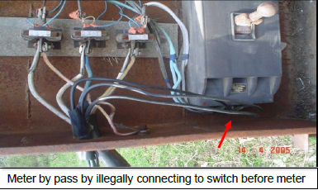

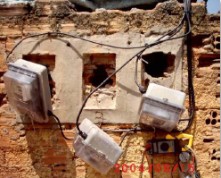
Physical Tampering Detection Solutions
Anti-tampering Alert
Reverse Rotation Alert
Disconnect Alert
Individual Limitaions
AMIDS: Advanced Metering Infrastructure with Detection System
11

Slide 12

Cyber Intrusion Detection Systems
This is implemented and deployed via firmware upgrade:
1) a remote cumulative attestation kernel (CAK) in meters
2) a specificationbased network intrusion detection systems deployed on access points or dedicated sensors in the local neighborhood area network Alerts : Spec- Based Network Monitoring
Remote Firmware Attestation
Meter Authentication logs
Meter Responsiveness
AMIDS: Advanced Metering Infrastructure with Detection System
12

Slide 13


Power Measurement-based Anomaly Detection
Load profile data available from smart meters.
Uses Naive Bayes algorithm .
Two power measurement-based detection solutions based on supervised and unsupervised machine learning techniques.
AMIDS: Advanced Metering Infrastructure with Detection System
13

Slide 14
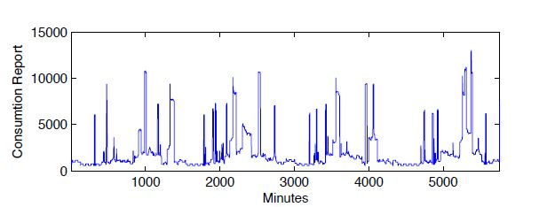
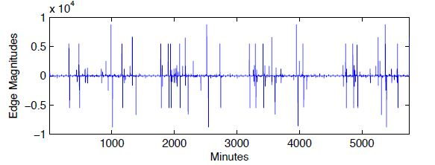
Supervised Anomaly Detection
AMIDS: Advanced Metering Infrastructure with Detection System
14

Slide 15
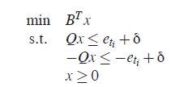
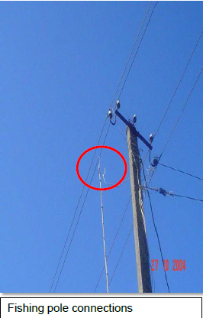
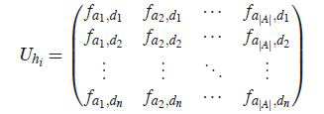
AMIDS: Advanced Metering Infrastructure with Detection System
15

Slide 16
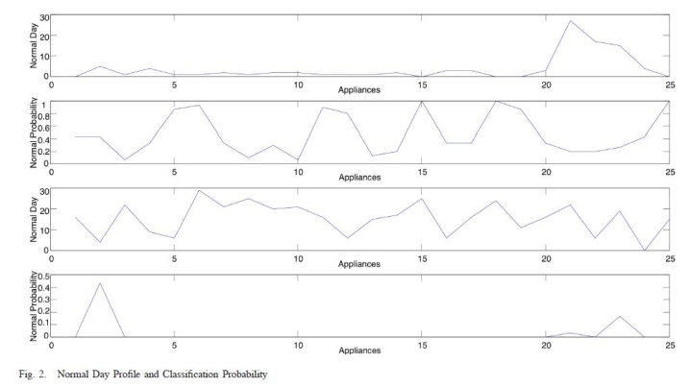
AMIDS: Advanced Metering Infrastructure with Detection System
16

Slide 17

Unsupervised Anomaly Detection.
AMIDS: Advanced Metering Infrastructure with Detection System
17

Slide 18
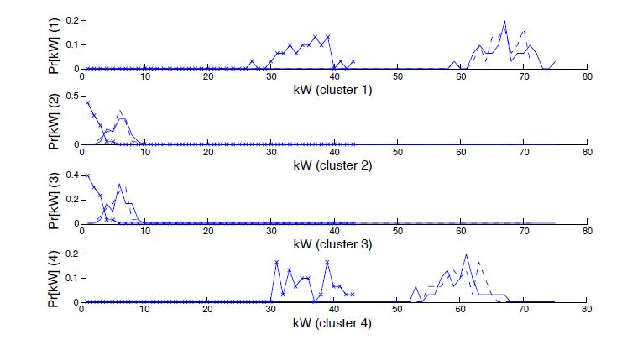
AMIDS: Advanced Metering Infrastructure with Detection System
18

Slide 19
MULTI-SOURCE INFORMATION FUSION
Individually reported fairly large numbers of false positives and sometimes miss intrusions.
To improve the overall accuracy, AMIDS makes use of a novel model-based solution to correlate alerts and provides operators with contextual Information , it uses a attack graph .
AMIDS: Advanced Metering Infrastructure with Detection System
19

Slide 20
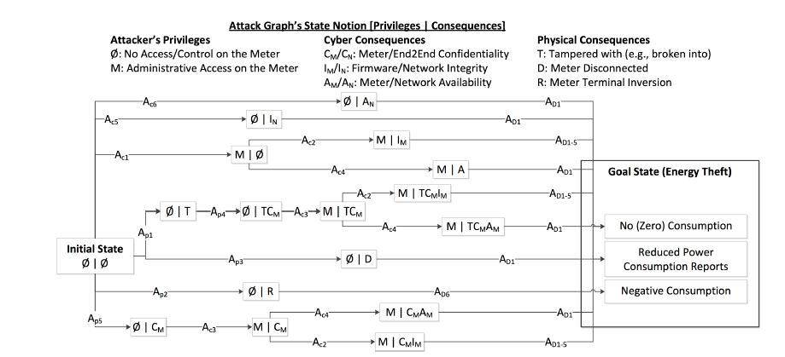
AMIDS: Advanced Metering Infrastructure with Detection System
20

Slide 21

EXPERIMENTAL EVALUATIONS
Testbed : Trustworthy Cyber Infrastructure for the Power Grid (TCIPG) center , University of Illinois at Urbana-Champaign. Load Profile Datasets : Baseline
Legitimate Changes
Legit-Replace
Legit-Season
Legit-Occupant
Malicious Changes
Mal-Bypass
Mal-Disconnect
Mal-Reduction
AMIDS: Advanced Metering Infrastructure with Detection System
21

Slide 22
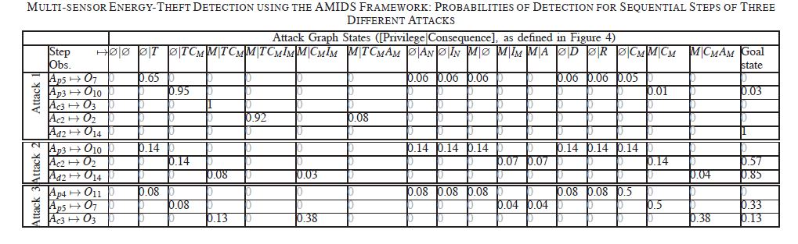
Integrated Intrusion Detection
AMIDS: Advanced Metering Infrastructure with Detection System
22

Slide 23
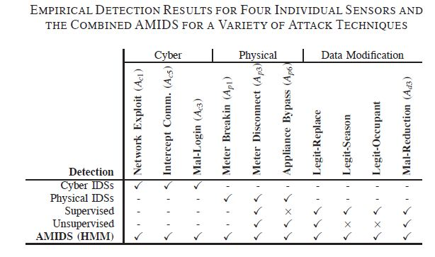
Accuracy
AMIDS: Advanced Metering Infrastructure with Detection System
23

Slide 24
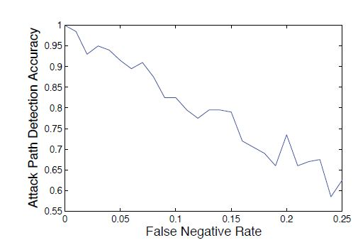
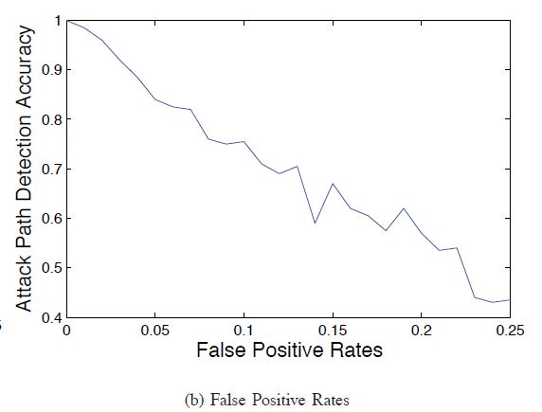
AMIDS: Advanced Metering Infrastructure with Detection System
24

Slide 25
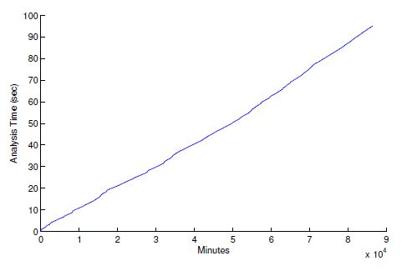
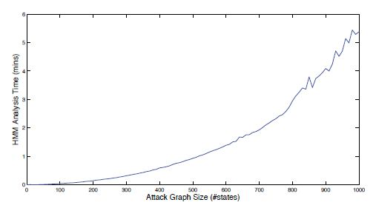
Performance
AMIDS: Advanced Metering Infrastructure with Detection System
25

Slide 26
RESULTS and future scope
Identify malicious energy theft efforts effectively.
But a limitation of AMIDS is the privacy violation concerns. AMIDS can make use of cryptographic privacy preserving solutions.
AMIDS: Advanced Metering Infrastructure with Detection System
26

Slide 27
Conclusion
AMIDS, an integrated intrusion detection solution to identify malicious energy theft attempts in advanced metering infrastructures.
AMIDS makes use of different information sources to gather sufficient amount of evidence about an on-going attack before marking an activity as a malicious energy theft.
The experimental results show that through an effective information fusion and using the correlation among the triggered alerts, AMIDS can detect various types of energy theft attempts accurately using individually inaccurate sensors.
AMIDS: Advanced Metering Infrastructure with Detection System
27

Slide 28
REFERENCES
FBI: Smart Meter Hacks Likely to Spread. Available at http://
krebsonsecurity.com/2012/04/fbi-smart-meter-hacks-likely-to-spread/.
S. McLaughlin, D. Podkuiko, and P. McDaniel, “Energy theft in the advanced metering infrastructure,” in Proc. international conference on Critical information infrastructures security. Springer-Verlag, 2010,pp. 176–187. International Journal of Innovative Research in Computer and Communication Engineering (An ISO 3297: 2007 Certified Organization) Vol.2, Special Issue 1, March 2014 . Cumulative Attestation Kernels for Embedded Systems ,Michael LeMay and Carl A. Gunter Specification-based Intrusion Detection for Advanced Metering Infrastructures Robin Berthier and William H. Sanders
AMIDS: Advanced Metering Infrastructure with Detection System
03

Slide 29



Slide 30
Questions ???
AMIDS: Advanced Metering Infrastructure with Detection System

